Slide 1

Integrating into GxP Medical Research
Lyn Taylor
Feb 2024

Slide 2
Disclaimer
The information contained in this presentation represents the views and opinions of myself and does not necessarily represent the views or opinions of parexel.
Contributions to this talk are a result of many working groups and multiple collaborators, many of whom I will thank as I go through the slides

Slide 3
Agenda
What was stopping the use of R in the medical research industry and what’s changed ?
Summary of working groups
CAMIS project
Ideas for the Future

Slide 4
What was stopping the use of R in Pharma and What’s changed?

Slide 5
Why is Medical Research Different?
GxP is a set of regulations and quality guidelines that aim to address the safety of the pharmaceutical product in a systematic and wholesome manner while maintaining the quality of processes throughout every stage of manufacturing, control, storage, and distribution.
https://www.scilife.io/glossary/gxp

Slide 6

What was stopping the use of R in Pharma?
General belief that R could not adequately support a GxP environment
“R is open source, uncontrollable and non-static so not suitable for GxP”
“Packages can not be adequately controlled or tested”
Lack of demand by Leaders & Staff in GxP environment
Everyone uses SAS
Expensive to change
Pharma is risk averse
So why bother?

Slide 7
SAS® Software
Free Software
Fixed Version Environment
Fast to adopt new methodology
Wide functionality & easy graphics
Staff already trained to use
R community users support
Validated by SAS®
Speaks to other software
Status Quo
Interactive reporting & metadata efficiencies
SAS Customer Support
New starters (Uni levers) know R already
Notes:
If we look at the pros and cons of SAS & R,
In 2018, whilst, R remained not being used much in GxP, there was rapid growth to use it in the non-GXP area within Pharma.
This demonstrated that if we could sort the issues with environment, training & validation, then there would be demand to change.
Since the functionality in other areas was more advanced that the current SAS GRID environment.

Slide 8
Cross Industry Working Groups

Slide 9

Key Collaborations /Organizations
Notes:
So this is where the Collaborations started… each with a slightly different focus and trying to resolve the bigger issues such that R use could grow in GXP.
Key collaborations / organizations leading projects in this field are:
Most of these I’ll mention their projects on later slides
The CDISC Open-Source Alliance (COSA) supports, promotes, and sometimes sponsors open-source software projects that create tools for implementing or developing CDISC standards to drive innovation in the CDISC community.
DVOST is a working group in PHUSE which has a number of projects writing White papers on the use of open source technology. CAMIS is part of this working group.
PSI AIMS SIG: Focuses on R.
R Pharma conference.
Pharmaverse – recently into collaboration with PHUSE

Slide 10
Pharmaverse - SDTM
https://pharmaverse.org/e2eclinical
Packages designed for End to End Clinical reporting (From SDTM to TFLs)
Coming Soon !
Notes:
Also RTRS working groups & Submission working groups.
R validation hub – for package risk assessment.

Slide 11
Pharmaverse- ADaM
https://pharmaverse.org/e2eclinical
Notes:
Also RTRS working groups & Submission working groups.
R validation hub – for package risk assessment.

Slide 12
Pharmaverse- Tables
Notes:
Also RTRS working groups & Submission working groups.
R validation hub – for package risk assessment.

Slide 13
Pharmaverse- Plots
Notes:
Also RTRS working groups & Submission working groups.
R validation hub – for package risk assessment.

Slide 14
Pharmaverse- Interactive & Frameworks
Coming Soon !
Notes:
Also RTRS working groups & Submission working groups.
R validation hub – for package risk assessment.

Slide 15
Notes:
New package to create FDA SMQs – per guidance rf
Want HTML files not shiny & not pDF.
PharmaDevOps PHUSE project as part of DVOST
phuse-org/devops (github.com) – tools to ensure better quality packages. CICD (Continuous integration & Continuous delivery)

Slide 16
Pharmaverse- Tools
Notes:
Also RTRS working groups & Submission working groups.
R validation hub – for package risk assessment.

Slide 17
Why are open source packages good for pharma?
Within SAS each company writes company specific process/SAS macros/tools
Non-billable time / Reproduction of effort
When move companies have to re-learn their processes
Pharmaverse provides industry wide standard macros
Package/macro support and documentation thorough
Can employ new starters who would already be familiar with packages/macros
Modular building of packages/macros
More efficiency – less non-billable development time needed per company
Standardized TFLs means less project specific bespoke programming for common analyses / endpoints
Notes:
This team identified that instead of everyone developing their own macros to do the same regulatory standards, why not develop them in the open source and then the code can be shared. This has a hidden benefit, new starters currently have to learn company specific SAS macros, if you use open source packages, then moving companies you’ll use the same packages !!

Slide 18
R Tables for Regulatory Submissions Working Group (RTRS)
Goal of the working group is to create standards for creating tables that meet the requirements of FDA submission documents, and hence enhance the suitability of R for FDA submissions. https://rconsortium.github.io/rtrs-wg/
18
Notes:
Today I’ll talk a bit about R validation Hub and Submissions activities, and Min-Hua will talk more about CSRMW project.

Slide 20
>100 members; >50 organizations
Mission: R Validation Hub is a cross-industry initiative whose mission is to enable the use of R by the Bio-Pharmaceutical Industry in a regulatory setting, where the output may be used in submissions to regulatory agencies.
Website www.pharmaR.org
Email to join the mailing list:
RConsortium-Validation-Hub+subscribe@lists.r-consortium.org
20
Notes:
Riskmetric App and package

Slide 21
Key Achievements 2018-2023
White paper
Tools
R Adoption series of talks
21
Notes:
Riskmetric App and package –Blog posts/presentations/case studies: www.pharmaR.org
ASA BIOP report publication (Vol29, No.3 Fall 2022). Risk Assessment of R Packages: Learnings And Reflections

Slide 22
White Paper
Provides arguments that there is minimal risk in using Core R for regulatory analysis and reporting
Suggests a pipeline for risk-based assessment of contributed R packages based on
Intended use
Type of implemented method
Maintenance quality
Community usage
Remediation and testing
Contributed
Recommended
Base
Popular
https://www.pharmar.org/white-paper/
With Thanks to Andy Nicholls.
Notes:
base and recommended (core) packages - developed by the R Foundation and shipped with the basic installation
contributed (open source) packages - developed by anyone, and may differ in accuracy

Slide 23
{riskmetric} package
Notes:
The {riskmetric} R package supports risk-based validation R packages.
Its an interface to collect package information from a
variety of sources such as public package repositories, public source code repositories, local source code or locally installed package libraries
pkg_ref(): builds a collection of package metadata which may be helpful for a risk assessment.
pkg_assess(): derives a number of package metrics from this metadata
Finally, pkg_score() consolidates the metrics into numeric indications of their quality and allowing for aggregate comparison of individual packages or package cohorts.

Slide 24
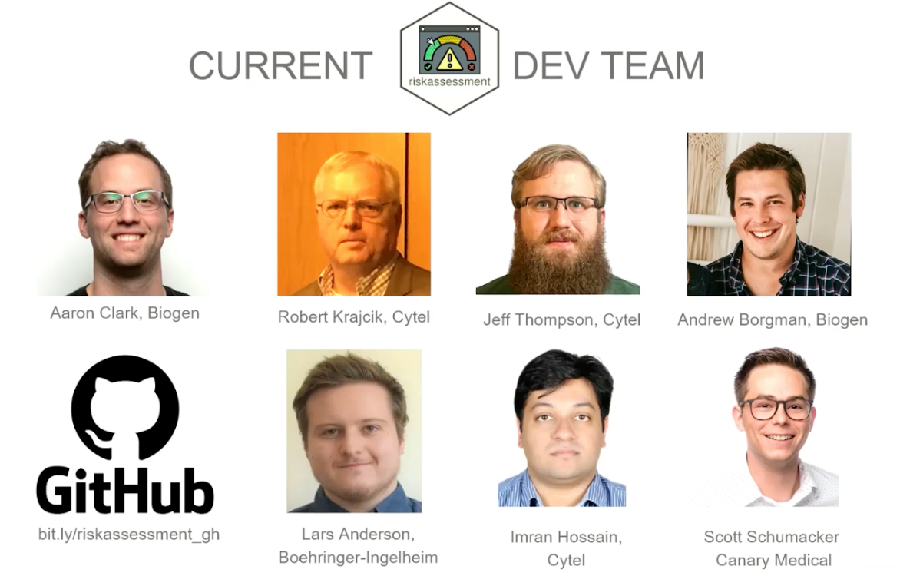
{riskassessment} app
Voted best Shiny app at shinyConf 2023!
The Demo app: https://rinpharma.shinyapps.io/riskassessment/
GitHub: https://github.com/pharmaR/riskassessment
User guide: https://pharmar.github.io/riskassessment/
Get Involved: https://pharmar.org
The 2nd Annual Shiny Conference was held March 15-17, 2023. It was all-virtual with over 4k global registrants. Aaron Clark, from the R Validation Hub Executive Committee, presented on the {riskassessment} app.
Notes:
The shiny application has the following functionalities:
- inherits the advantages of the shiny R package, i.e. no R programming knowledge is needed to use the application,
- gathers information on community and maintenance metrics of the package,
- has embedded authorized personnel that can perform risk assessments and modify metric weights depending on the user access level,
allows users to provide feedback on the risk calculated by riskmetric,
stores historical comments and final decisions,
- contains a reporting tool that allows users to share the assessment insights with other reviewers as either a Word Document or an HTML file

Slide 25
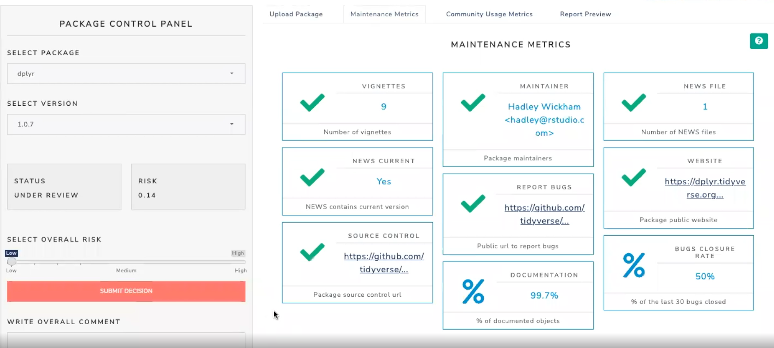
Risk Assessment App
Notes:
This is our view once we have selected a package…

Slide 26
Company adoption of R

Slide 27


R adoption Examples
Organized by Juliane Manitz – R validation Hub
2022 All-Hands Case Studies https://github.com/pharmaR/case_studies
Merck
Novartis
Roche
2022 June PSI Conference Adoption Examples https://psiweb.org/docs/default-source/psi-events---member-only-access/using-r-for-regulatory-work-(combined-slides).pptx?sfvrsn=7700a3db_0
GSK
PHASTAR
2023 September: Novo Nordisk's Journey to an R based FDA Submission - YouTube
https://www.pharmar.org/casestudies/
Notes:
The Roche repositories

Slide 28
R Adoption: Common Themes
All implementations follow the risk validation process for R packages as outlined in the white paper
Classification of package quality into high/medium/low or a binary high/low categorization, however the approach to the assessments themselves varies.
High importance of test coverage as assessment metric
Trusted resources: R Foundation, thus core R (base and recommended packages) are treated as a collective of “low risk” packages; some organizations also trust Rstudio developments, i.e. tidyverse, etc.
The majority focused risk assessments only on “Intended-for-Use” packages but several also ran metrics on the Imports.

Slide 29
R Adoption: Differences in Approaches
Varied degrees of automation in risk classification and qualification i.e. either complete automation or no automation
Different weights were assigned to the testing coverage and various suggested metadata metrics: acceptable threshold for test coverage ranges between 50-80% for low-risk packages
Different risk remediation strategies have been applied:
some organizations will immediately introduce their own unit tests,
others restrict package use to only the tested subset of package functionality.
Some companies test functions and run scripts to ensure only the allowed functions are being used within packages

Slide 30
R Adoption: Common Challenges
R package assessment is a resource-intense activity
Time has proven to be a considerable challenge.
Ensuring R package reviewers have the right technical expertise
Alignment of different contributors across the organization: IT, Quality Assurance and with their own Statistics, Data Science, or Programming lines.
Finding appropriate test datasets, test cases and expected model output
Long-term management and maintenance as well as oversight of the risk-based package assessment process

Slide 31
The Pathway to testing FDA Submissions in R

Slide 32
R Submission Pilot 1
Yilong Zhang (Merck) and Ning Leng (Genentech)
Submission v0.1.0 sent to FDA in Nov 2021
https://github.com/RConsortium/submissions-pilot1-to-fda
32

Slide 33
R Submission Pilot 1
FDA Response
Using R version 4.1.1, FDA was able to run the submitted code and confirm the applicant’s tables and the submitted figure in report-tlf pdf file.
Using FDA developed code, a statistical analyst was able to independently generate tables using submitted data. There are some minor issues with some of the tables that were submitted….
Version 0.1.1 was created and response provided to FDA: Feb 2022.
FDA response:
https://github.com/RConsortium/submissions-pilot1-to-fda
33

Slide 34
R Submission Pilot 2
Tested creation of a Shiny App as an R package which was successfully transferred to the FDA using the eCTD gateway protocol. https://github.com/RConsortium/submissions-pilot2
R Submission Pilot 3
An ADaM extension to pilot 1, eCTD format,
https://github.com/RConsortium/submissions-pilot3-adam
https://github.com/RConsortium/submissions-pilot3-adam/blob/main/vignettes/fda/R_Submission_Pilot_3_ADaM_FDA_Execution_Proposal_02Dec2022.pdf
R Submission Pilot 4
Building on pilot 2, exploring new novel technologies to bundle the application (Containers & WebAssembly)
https://rconsortium.github.io/submissions-pilot4/
34

Slide 35
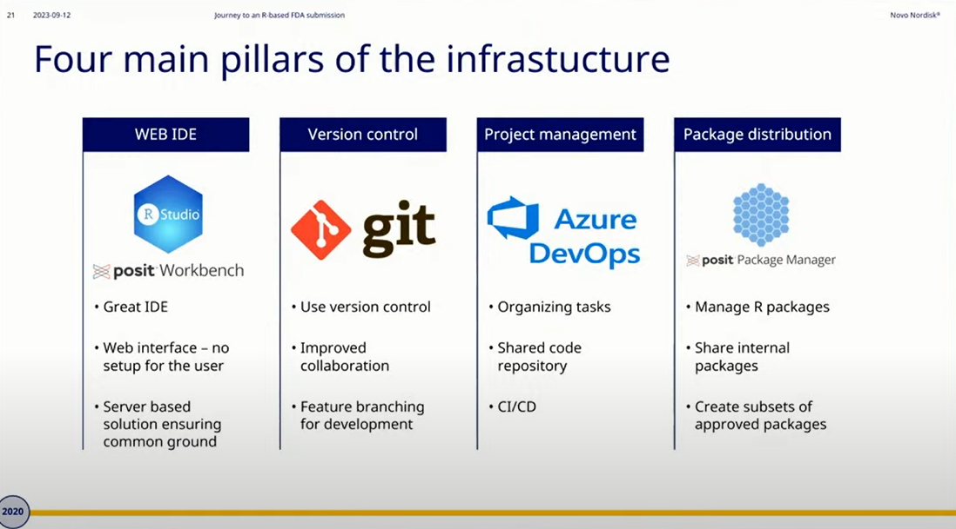
NovoNordisk – Presentation October 2023
Novo Nordisk's Journey to an R based FDA Submission – YouTube
2015 No use of R or git to 2023 successful submission of first study to FDA solely in R

Slide 36
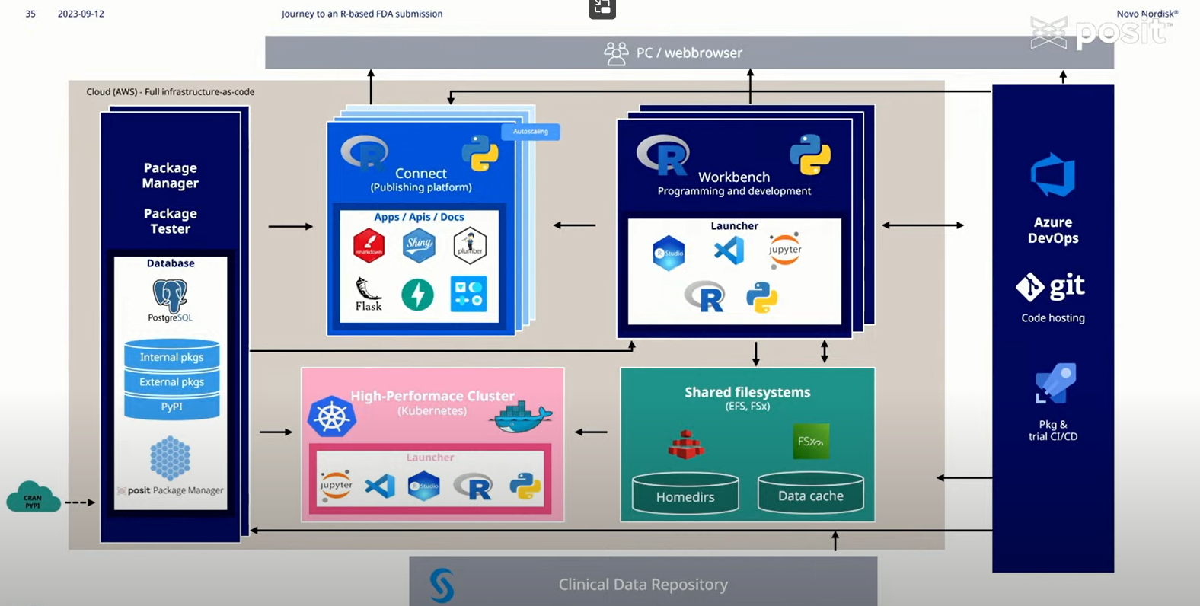
NovoNordisk

Slide 37
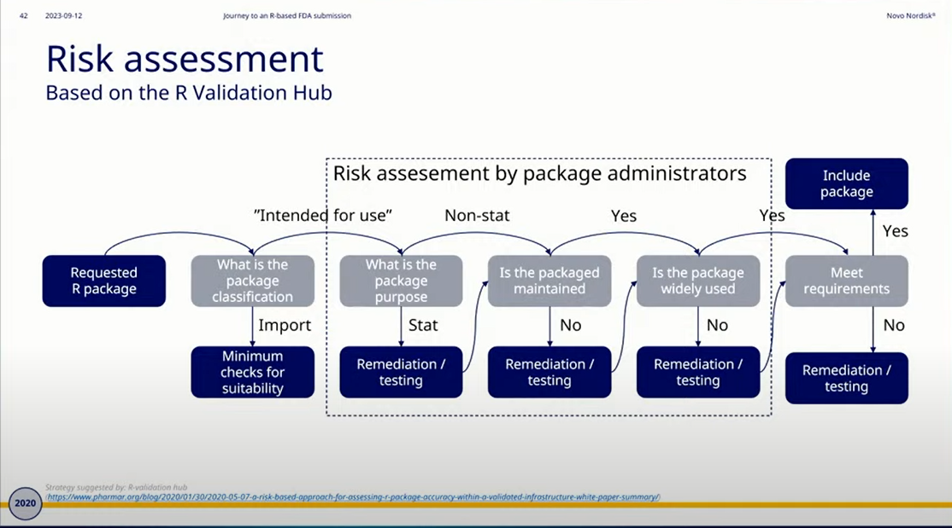
NovoNordisk

Slide 38
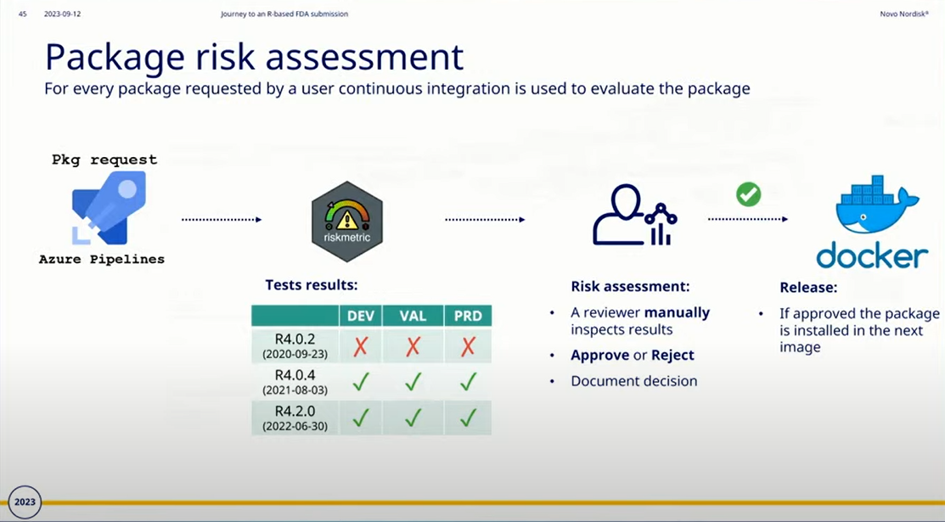
NovoNordisk

Slide 39
NovoNordisk
Were using ‘NN’ packages (internally developed)
Submitted to FDA including detailed ADRG with “Instructions to run programs in R”
On 2nd attempt, FDA were successful in restoring R environment and running programs
The internally developed packages made it harder for FDA to review
So NovoNordisk are now Fully embracing open-source and contributing to PharmaVerse !

Slide 40
Submissions
Successful pilot
Successful NovoNordisk submission
NovoNordisk now doing 30-40% of their trials fully in R and increasing
Other companies following this trend.

Slide 41

Comparing Analysis Method Implementations in Software (CAMIS)

Slide 42
Differences Exist Between Software
Rounding
Explains how results on knife edge are rounded (e.g. 1.2345)
As default base R will round ‘to even’ (e.g. 1.234)
SAS will round ‘away from zero’ (e.g. 1.235)
Explains how to make R and SAS give the same answers
Use janitor package: round_half_up()
Use SAS rounde function

Slide 43
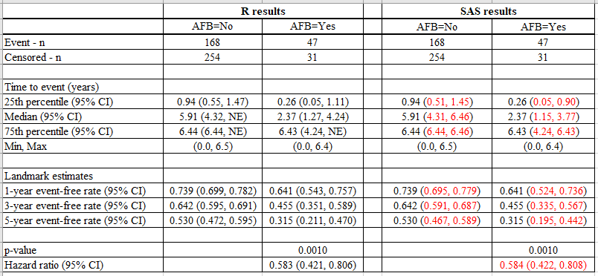
Project 12345 – R vs SAS Results
With Thanks to Mia Qi & Min-Hua Jen

Slide 44
The CAMIS repository – Survival Analysis
Discrepancies between SAS and R can be caused by:
Default methods for handling ties in cox model are different: R uses “Efron”, SAS uses “Breslow”.
Default methods for CIs for KM estimators: R uses “log”, SAS uses “log-log”
No events after the median survival probability
SAS selects smallest event time for which the survival estimate is <0.5 (median)
R selects the mid-point of the times, with survival estimate at 50%
No events after a Landmark Estimate
SAS returns value of NE
R carries forward the survival estimates from the latest timepoint that an event occurred
With Thanks to Mia Qi & Min-Hua Jen

Slide 45
CAMIS White Paper
https://phuse.s3.eu-central-1.amazonaws.com/Deliverables/Data+Visualisation+%26+Open+Source+Technology/WP077.pdf
The white paper is a following to: ASA BIOP report publication (Vol29, No.3 Fall 2022). Understanding differences in statistical methodology implementations across programming languages. Rimler M, Rickert J, Jen M-H, Stackhouse M.

Slide 46
CAMIS White Paper
Key Message:
Don’t use the defaults because they are default
Put into the SAP which method & why based on the data
Fully specify the method
This should allow reproducibility in any language
Notes:
The white paper describes a 4 point process to ensure analysis is clearly specified such that it isn’t reliant on software default settings which can change across software
Define the research question – often in the protocol/ SAP. Hence the first step of the analysis statistician should be to familiarise themselves with the research questions. If the clinical data scientists does not keep this in mind, the remaining steps will turn into a cycle that remains unguided in the overall purpose of the study in question
Define the statistical design to examine the research questions. The statistical designs are often informed by the protocols and procedures set in an experiment. Considerations such as estimands, randomization based on inclusion/exclusion criteria, stratified analyses, etc. help determine the model-making process.
Look at the technical aspects
basic literature search to determine how to implement the statistical models as specified. There are a variety of packages that exist that may perform the same analyses, but utilize other kinds of optimization routines in the backend. Here is a starting list of questions to consider: • Which model (and corresponding summary statistics) should be used to answer the research question based on the study design? • What are the key factors of the model, e.g. coefficient and variance estimation procedures, missing data strategy? • Can the analysis be carried out in R, or SAS, or some other platform that is available to the organization? • If the analysis can be implemented in both R and SAS, what are the differences in documentation of the key factors? These questions should be answered in context of the statistical design and be consistent with the organization’s previous practices in similar trials where applicable.
Collection of data and the question to be analyzed should be the driver for the methods of analysis. Simply a method being the “default” in your software should not be a areason to use that option !!!
4) Carry out the pre-specified analysis and display the results.

Slide 47
CAMIS White Paper
Key Message:
Don’t use the defaults because they are default
Put into the SAP which method & why based on the data
Fully specify the method
This should allow reproducibility in any language
Notes:
The white paper describes a 4 point process to ensure analysis is clearly specified such that it isn’t reliant on software default settings which can change across software
Define the research question – often in the protocol/ SAP. Hence the first step of the analysis statistician should be to familiarise themselves with the research questions. If the clinical data scientists does not keep this in mind, the remaining steps will turn into a cycle that remains unguided in the overall purpose of the study in question
Define the statistical design to examine the research questions. The statistical designs are often informed by the protocols and procedures set in an experiment. Considerations such as estimands, randomization based on inclusion/exclusion criteria, stratified analyses, etc. help determine the model-making process.
Look at the technical aspects
basic literature search to determine how to implement the statistical models as specified. There are a variety of packages that exist that may perform the same analyses, but utilize other kinds of optimization routines in the backend. Here is a starting list of questions to consider: • Which model (and corresponding summary statistics) should be used to answer the research question based on the study design? • What are the key factors of the model, e.g. coefficient and variance estimation procedures, missing data strategy? • Can the analysis be carried out in R, or SAS, or some other platform that is available to the organization? • If the analysis can be implemented in both R and SAS, what are the differences in documentation of the key factors? These questions should be answered in context of the statistical design and be consistent with the organization’s previous practices in similar trials where applicable.
Collection of data and the question to be analyzed should be the driver for the methods of analysis. Simply a method being the “default” in your software should not be a areason to use that option !!!
4) Carry out the pre-specified analysis and display the results.

Slide 48
The CAMIS repository
Thanks Christina Fillmore!
https://psiaims.github.io/CAMIS/
For each Method the repository contains
Application in R
Application in SAS
Comparison between software results / noting differences
We hope to expand to include Python, Julia and/or other software
Notes:
So the repository isn’t just to showcase R… it’s to get people thinking again about what analysis you are doing… what is the software doing..
Thank you christina !
The repository is now LIVE and we are building up examples of the methods applied in R, SAS and documenting any differences between how the software performs the statistical method.
NOTE: we hope to expand to include Python, Julia & other software in the future.
When you get to the CAMIS home page, you will see a Table of methods. If a link exists then we have already created documentation for that method.
If no link exists and you have content you would like to add then please get in touch with us.

Slide 49



Call for Action – How you can help?
Documenting how to perform statistical methods in R, SAS or comparing them
Adding to the repository differences between R & SAS that know about
You can be a contributor or JOIN US on the PHUSE working group
Adding content for Python, StatXact, Julia or other software
Review/ revision of existing CAMIS content.
Notes:
This presentation is a call for Action - so here is how you can help us to build a high quality comprehensive repository.
Would you be interested in documenting how to perform a statistical method in R, SAS and comparing them? Our github repo has a list of issues awaiting investigation. If you would like to contribute to a specific are then please get in touch to be assigned.
Do you already have some content that you would like to load to the site which documents some difference between the was SAS and R do statistical analysis. If so please get in touch and we can show you how to load to the site
Do you want to explore other software?
Are you a statistical expert and would like to review our content to ensure our methods and documented correctly. Then please review our existing CAMIS content and do a pull request to suggest changes/ corrections.
This is a community led effort so the more people we have contributing the more comprehensive the project can become.
You can be a contributor or join the PHUSE working group which meets monthly.

Slide 50
The Future Collaborations

Slide 51

Summary of achievements
Companies are transitioning to R
Framework and tools for risk assessment
Framework and repo for differences in software
Packages being developed for SDTM,ADaM
Ongoing discussion with regulators
1st real company FDA submission a Success

Slide 52
What’s New for 2024? https://phuse-org.github.io/OSTCDA/

Slide 53
What could we do better
R Tests repository
Similar to CAMIS but storing tests that can be run on packages.
This would reduce the burden on each company writing their own tests
R pharma package repository
R validation hub currently exploring this concept
A package repo - similar to CRAN but with Pharma approved packages only
Where do we stand legally?
Open source have no liability or warranty if the analysis is wrong!

Slide 54

PSI AIMS SIG Members | Affiliation
Martin Brown (Chair) | PPD
Lyn Taylor (previous Chair) | parexel
Andy Nicholls | GSK
Christina Fillmore | GSK
Chris Toffis | Veristat
Jules Hernandez-Sanchez | Roche
Mark Bynens | JnJ
Michael Cartwright | parexel
Min-Hua Jen | Eli Lilly
Matthew Neilson | PHASTAR
Daniel Leibovitz | Incyte
Marie Laure Casadebaig | Incyte
Irene Vassallo | Incyte
Kevin Kunzmann | Boehringer-Ingelheim
Camilo Rojas Caifuentes | Janssen
Thanks all for Your Collaboration

Slide 55

CAMIS Members | Affiliation | CAMIS Members | Affiliation
Lyn Taylor (Co-Lead) | Parexel | Aiming Yang | Regeneron
Michael Rimler | GSK | Brian Varney | Expiris
Mike Stackhouse | Atorus | Kyle Lee | Elder Research Inc.
Joseph Rickert | Posit | Martin Brown | PPD
Christina Fillmore (co-lead & Website design lead) | GSK | Jayashree Vendanayamgam | Pfizer
Harshal Khanolkar | Novo Nordisk | Vikash Jain | Genpro research
Min-Hua Jen | Eli Lilly | Martin Brown | PPD
Mia Qi | J&J | Kevin Putschko | Expiris
Benjamin Arancibia | GSK | Wilmar Igl | Icon
Heliang Shi | Pfizer | Aditee Dani | Phastar
SomaSekhar Sriadibhatla | AstraZeneca | Vandana Yadav | Novo Nordisk
Molly MacDiarmid | Parexel | Iris Wu | Incyte
Chelsea Dickens | Atorus | Lilly Hsieh | Pfizer

Slide 56

R Validation Hub Exec Team | Affiliation
Doug Kelkhoff (Chair) | Roche
Andy Nicholls | GSK
Joseph Rickert | R Consortium/Posit
Juliane Manitz | Merck/Serono
Paulo Bargo | Janssen R&D
Lyn Taylor | parexel
Keaven Anderson | Merck
Eric Milliman | Biogen
Aaron Clark | Biogen
Preetham Palukuru | Merck
Thanks all for Your Collaboration

Slide 57
Thank you

Slide 58
Back up slides

Slide 59
Training
How do we upskill our workforce?
Start with basic tidyverse, then Learn on the job
If you train in a course & don’t apply it, you’ll forget it.
SMEs
Development of reporting R tools (Pharmaverse + beyond)
Know your audience and adapt training
Work icons created by Eucalyp - Flaticon
Notes:
Existing R user
reluctant adopters: Do not want to learn a new language
Early adopters: Happy to learn a new language
New Starters:
So hopefully I’ve shown that there is reason to bring the R in to PHARMA,, so lets take a deaper dive in to what collaborations are doing.

